Slide 1
Data analysis Q&A
Presented by Mary Kane

Slide 2

Welcome
CRISP – DM and the data analyst responsibilities.
Forecast Time Series Preparation.
Main principles of Data ethics.
Hypothetical case. How can we handle bias in a predictive model
Regression vs Classification models in predictive analysis

Slide 3
Quote
CRISP – DM
Cross-Industry Standard Process for Data Mining

Slide 4
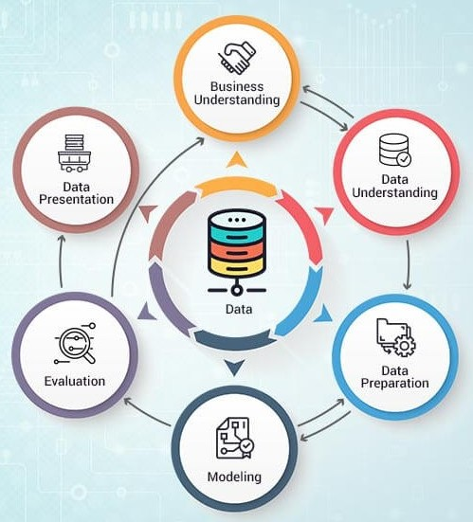
CROSS-INDUSTRY STANDARD PROCESS FOR DATA MINING
BUSINESS UNDERSTANDING. Define the problem, goals and success criteria.
DATA UNDERSTANDING. Initial quality evaluation and sense of patterns.
DATA PREPARATION. Clean, transform and select relevant information.
MODELING. Apply appropriate techniques (Regression vs Classification).
EVALUATION. Confirm if the model meets the original business objectives.
DEPLOYMENT. Deliver results and communicate insights.

Slide 5
Quote
FORECAST
TIME SERIES PREPARATION

Slide 6
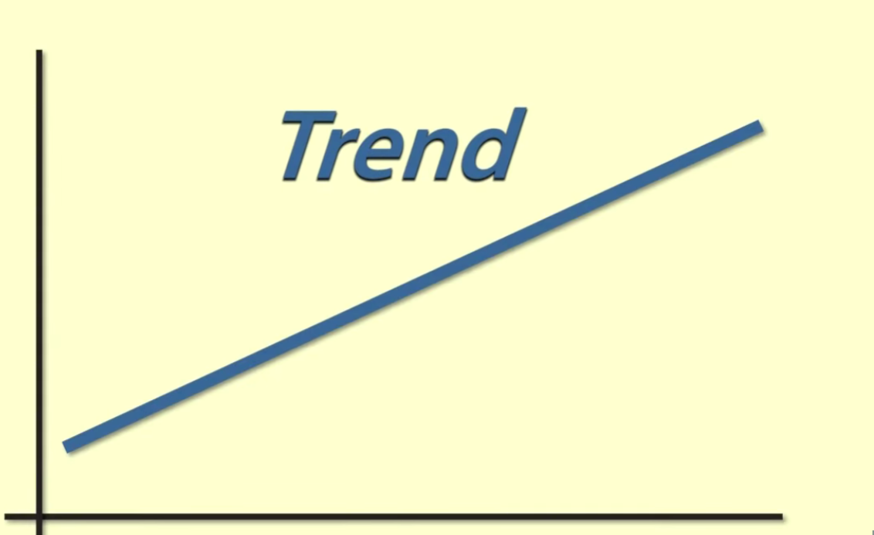
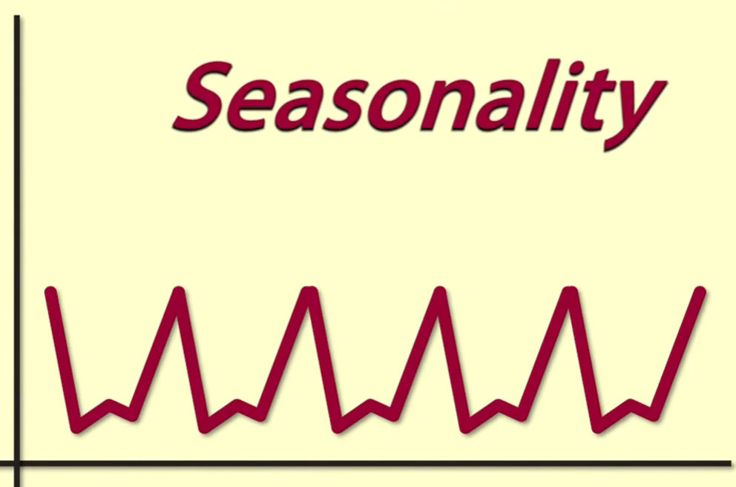
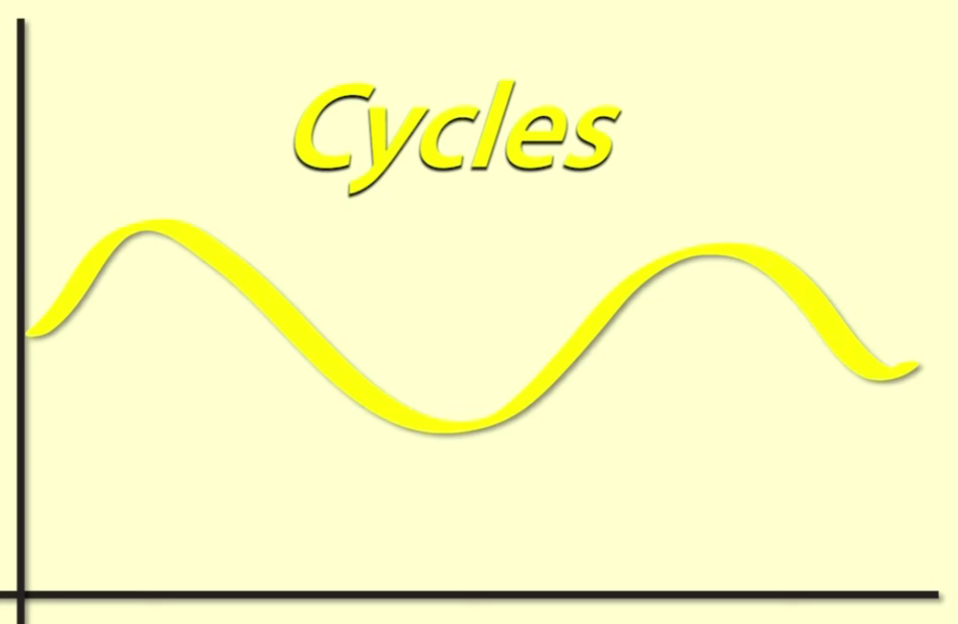
The prep before forecasting a time series analysis
1. Understand the structure of the time series, including trends, seasonality, and cycles.
TRENDS (Scatterplot and drawing a regression line, Positive, negative)
SEASONALITY (Patterns – Fluctuations that repeat regularly over the years)
CYCLE (residual fluctuations)
2. Statistical Properties, check if the data is stationary or needs transformation.
Mean, deviation (Do they remain stable over time?)
3. Clean the data, handling missing values, correcting errors, and addressing outliers.
4. Select the appropriate forecasting model and evaluate it using historical data.
ARIMA Model: Auto-Regressive Integrated Moving Average
PYTHON – PANDAS(TO FIND MISSING VALUES) – MATPLOTLIP (VISUALIZATION)
Conclusion: The time series analysis involves understanding patterns over time, preparing data carefully and validating assumptions before making any forecast.

Slide 7
Data ethics
Main principles

Slide 8
Ethic principles
PRIVACY Collect and use data only for legitimate purposes and to protect personal information.
TRANSPARENCY Be clear about data collection, use, and analysis.
FAIRNESS Minimize bias, include the entire population.
ACCOUNTABILITY Each organization takes responsibility for its data practices and decisions made.
SECURITY Ensure data is protected from unauthorized access or misuse.
Overall, ethical data practices help build TRUST with users and reduce legal and reputational risk.
Recommendations for organizations:
Implement strong data governance policies
Provide ethics training
Audit regularly models for bias
Limit access to sensitive data.

Slide 9

Quote
Hypothetical case
Imagine a financial services company presents a predictive model, and you have concerns about bias in how it was measured.
How would you raise your concerns with your manager?
how to avoid measurement bias in the future

Slide 10
Imagine a financial services company presents a predictive model, and you have concerns about bias in how it was measured
What to do: Gather evidence | Raise the concern to my manager | Recommendations for the future
Review data sources | Speak to my manager in a constructive and professional way | I would suggest using more representative datasets and validating models across multiple demographic segments
Evaluate metrics | Focus on the potential business and ethical risks | Involving diverse stakeholders in model reviews and documenting assumptions and limitations.
Collect the outcomes across different groups | Provide examples of how certain variables or sampling methods could affect fairness or accuracy. | Monitoring the model performance regularly.

Slide 11
Quote
Regression vs classification models

Slide 12

Selecting a Predictive model
Regression Model Used when the outcome variable is continuous, such as predicting revenue, price, or demand. For example, forecasting monthly sales would typically use regression.
Classification Model Used when the outcome is categorical, such as yes or no, approve or reject, or churn or not churn.

Slide 13
Thank you
For questions or access to the presentation slides, please reach out at:
Marykane.col99@gmail.com

